Slide 1
DATA ANALYSIS
File created on: 7/7/2022

Slide 2


Slide 3
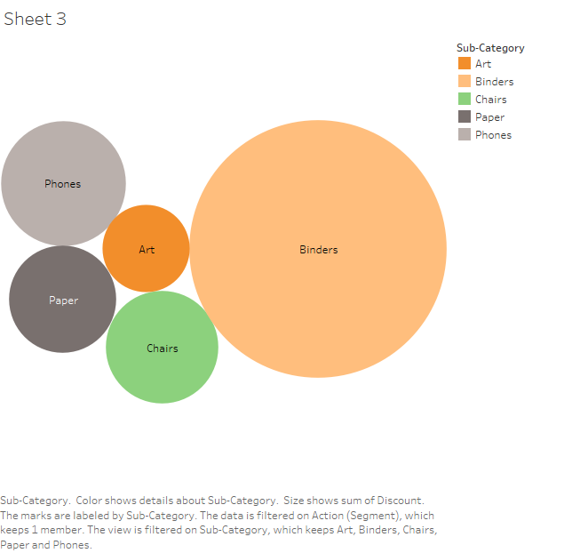

Slide 4


Slide 5
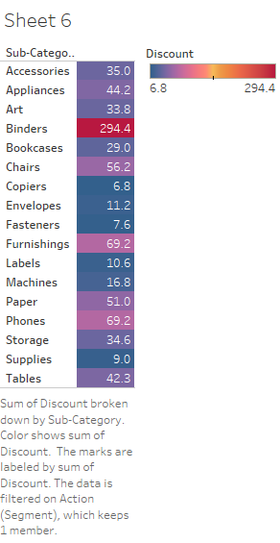

Slide 6
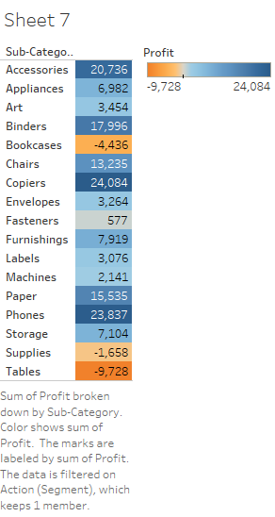

Slide 7
